Slide 1
Freezer Meals
Steph Erpelding
Sac County Extension and Outreach
County Youth Coordinator/Office Manager
Farm Wife/Mother of 3

Slide 2
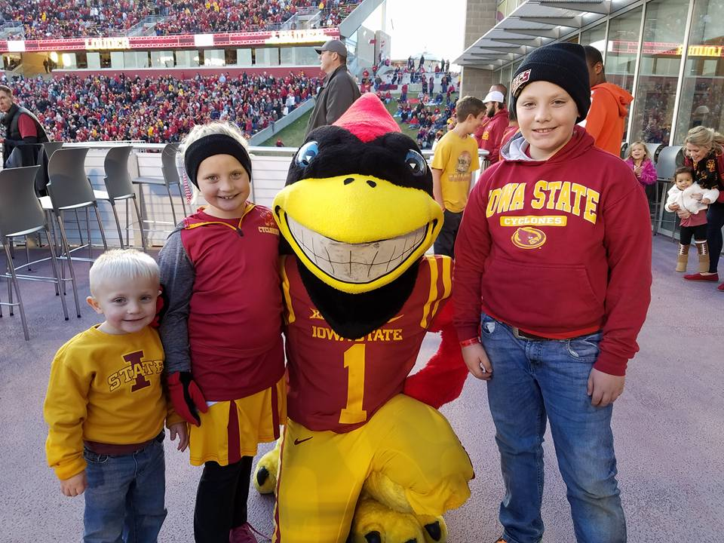
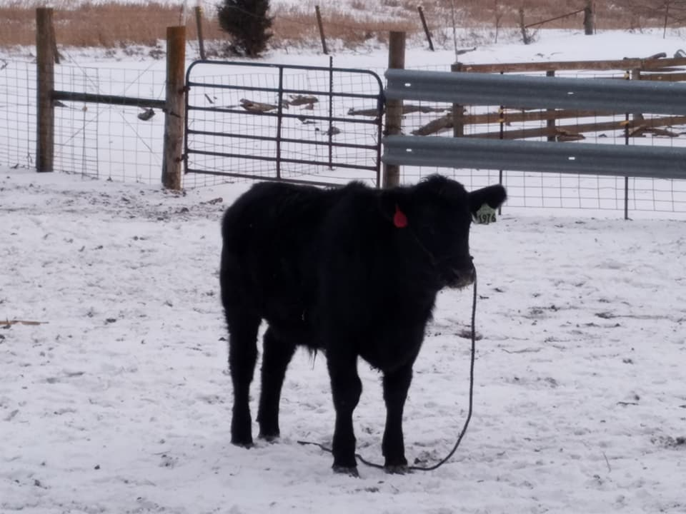
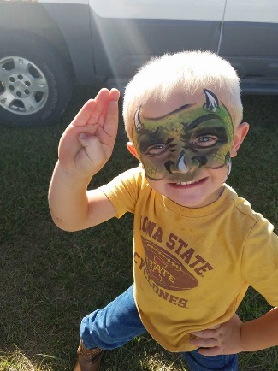
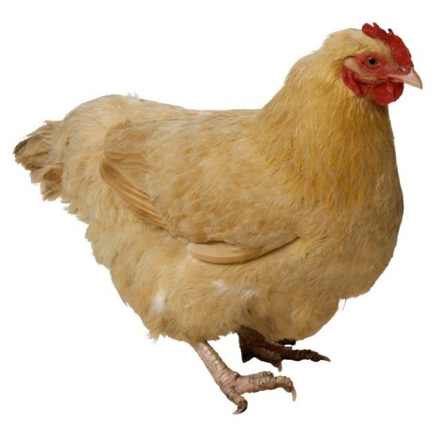
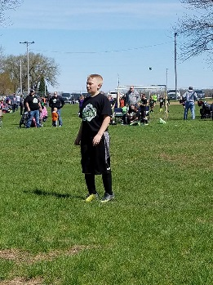
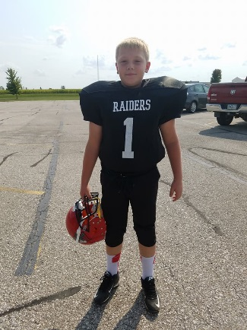
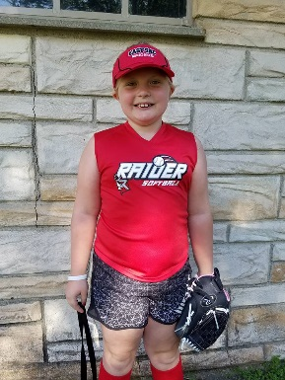
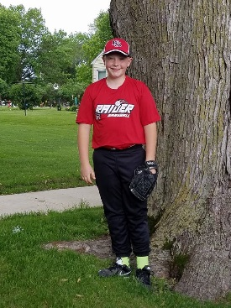

Slide 3
Why?
Saves Time
Saves $$
What’s For Supper?
Nutrition

Slide 4
Time Saver
*Saves meal prep
*Saves clean-up
*Saves you from running to the store every day
*You don’t have to waste time thinking about what to make for supper
*Pull a meal out for guests or as a kind gesture

Slide 5
Money Saver
*Saves from picking up a frozen meal
*Saves you from ordering out
*Buying in bulk
*Not buying items at the store every day

Slide 6
Tips & Tricks
*Plan out your menu
*Look at the grocery ads for deals
*Only make enough that will last for about 3 months
*Vacuum sealer helps to keep meats air tight
*Loaf pan perfect for 2 people
*Wrap with Saran wrap and then wrap with foil
*Different freezers – self defrosting vs. auto defrosting
*Casseroles freeze before baking – tastes better

Slide 7
Tips & Tricks Continued
*Undercook starchy foods like potatoes, rice and pasta
*Glass containers work well
*Don’t freeze meals that include boiled eggs, sour cream and mayonnaise
*Seasoning intensity – cloves, pepper, garlic and celery
*Fully cooked casseroles should not be thawed, bake at 400 for the time of the recipe
*Crockpot Recipes
*Make a family night of it!

Slide 8
Safety & Storage
Step 1 – Cool foods slightly at room temperature – use a cooling rack & limit depth of food to 2 inches
Step 2 – Complete cooling of foods in the refrigerator
Step 3 – Pack foods into Freezer Bags
Step 4 – Label Foods
Step 5 – Lay bags flat in freezer & stagger
Step 6 – Thaw frozen meals in refrigerator for 24 hours

Slide 9
Making Freezer Meals
*Double the recipe
*Moms night out
*Swap Nights
*Family Nights/Weekend Projects

Slide 10
Freezer Meal Ideas
Soups
Stews
Casseroles
Pasta Sauces
Meatballs
Meatloaf
Marinated meats
Burritos
Vegetables
Taverns/Sloppy Joes
Chicken Pot Pies
Taco/Fajita Meat
Pulled Pork
Lasagna
Apple Crisp

Slide 11
Resources
University of Nebraska – Lincoln – Freezing Cooked Food for Future Meals: Freezer Bag Tips – https://food.unl.edu/freezing-cooked-food-future-meals-freezer-bags-tips
Iowa State University Extension and Outreach AnswerLine 1-800-262-3804 Mon-Fri 9am-noon, 1-4pm
Blog – March 3, 2016 – Making Freezer Meals
Blog – July 24, 2014 – Preparing Meals for the freezer
Blog – June 1, 2017 – Freezer food for after baby arrives

Slide 12
Hamburger and Noodle Dish
2 lbs. ground beef
1 sm. Onion chopped
1 (12 oz.) pkg. frozen egg noodles
2 cans pizza sauce
1 (8 oz.) pkg. mozzarella cheese
Brown ground beef and onion together; drain excess grease. Cook noodles according to package directions and drain. Mix together browned hamburger, onion, noodles and pizza sauce. Put in greased 9x13 inch pan. Sprinkle with mozzarella cheese. Bake at 400 degrees for about 10 minutes or until cheese has melted.
Source: Lynette Tiefenthaler

Slide 13
Taco Seasoning Mix
This recipe makes the equivalent of six (1.25 oz.) packages
¼ cup dried minced onion
1 Tbsp. garlic powder
2 Tbsp. chili powder
1 Tbsp. dried oregano
1 Tbsp. cornstarch
1 Tbsp. ground cumin
1 Tbsp. crushed dried red pepper
Combine all ingredients; mix well. Place in storage container with a tight-fitting lid; seal tightly. Store in a cool, dry place for up to one year. Stir or shake well before each use.
To use as a substitute for commercially prepared taco seasoning mixes, measure 2 Tablespoons per pound of hot, cooked, ground meat. Then add 8 ounces (no added salt) tomato sauce to the cooked ground meat/seasoning mixture. Spoon meat mixture into taco shells and top with cheese, shredded salad greens, tomatoes, and other desired toppings.
Yield: 4 servings, 1 taco per serving.
Source: Words on Wellness January 2011

Slide 14
Peanut Butter Balls
Ingredients
1 can (15 ounces) great northern beans (drained and rinsed)
1/3 cup honey
1 tablespoon vanilla
1 1/4 cups peanut butter
1 1/2 cups quick cooking oats
Instructions
1. Mash the great northern beans with a fork in a bowl until smooth.
2. Add the honey and vanilla. Stir.
3. Add peanut butter. Stir until blended.
4. Stir in the oatmeal.
5. Wash hands. Use a tablespoon to scoop up some of the peanut butter mixture. Shape the mixture into balls (makes 50 balls).
6. Store leftover balls in an airtight container in the refrigerator.
Source: Spend Smart Eat Smart

Slide 15
Questions??

